Slide 1

INT 200:Human Pose Estimation for Arthritis Disorder using Deep Learning Techniques
INT 200 Internship
First Review
Team Members
1. K .Aakash (E0221041)
2. R .Tarun Raaj (E0221024)
Project Guide
Prof .Nirmala Balasundaram

Slide 2
Introduction
Our fast-paced lives these days, people usually prefer exercising at home but feel the need of an instructor to evaluate their exercise form.
As these resources are not always available, human pose recognition can be used to build a self-instruction exercise system that allows people to learn and practice exercises correctly by themselves.
The problem with yoga however is that, just like any other exercise, it is of utmost importance to practice it correctly as any incorrect posture during a yoga session can be unproductive.

Slide 3
Problem statement
Human pose estimation is a deep-rooted problem in computer vision that has exposed many challenges in the past.
Analyzing human activities is beneficial in many fields like video surveillance, biometrics, assisted living, at-home health monitoring etc.
It deals with localization of human joints in an image or video to form a skeletal representation.

Slide 4
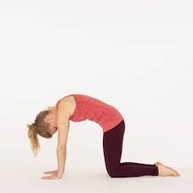
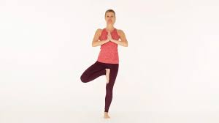
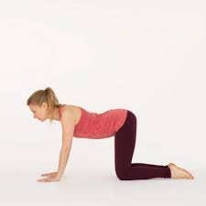
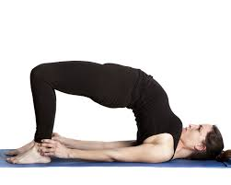
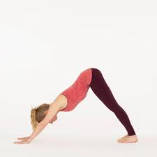
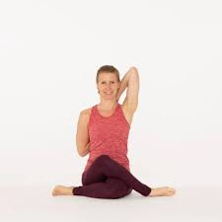
Yoga poses for Arthritis Relief
Cat Pose
Tree Pose
Cow Pose
Bridge pose
Downward Facing Dog Pose
Cow Face Pose

Slide 5
Research survey
S.no | Title | Author | Year | Overview
1 | Compter Vision and Image Understanding | Nikolaos Sarafianos | 2016 | 3d pose estimation from RGB images and videos using CNN for classification of yoga poses.
2 | Yoga Pose Classification Using Deep Learning | Shruti Kothari | 2020 | Used OpenPose for initial keypoint identification from videos as input followed by CNN for classification of yoga poses.

Slide 6
Work Flow
Data Collection
What data exists
Data preparation
Train a model
Analysis/evaluation
Serve model
Retrain model
Where can you get it? Is it public? Are there privacy concerns?
Is it structured or unstructured
Exploratory data analysis(EDA)
Data Preprocessing
Data Splitting
Choose an algorithm (based on your problem/data)
Overfit them regularize
Tune hyperparameters
Evaluation metrics
Feature importance
Training/inference cost
Worst examples
Put your model in production
Revaluate
Are old predictions still valid?
Continuous process
Collect more data for improve model

Slide 7
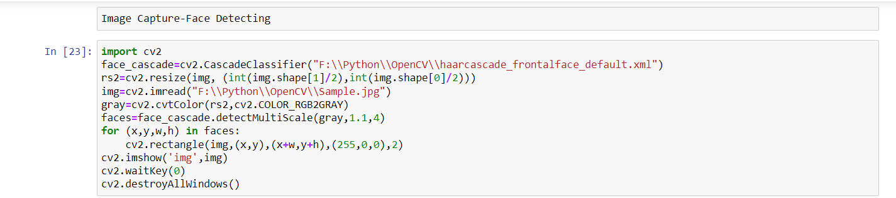
Work done(1/5)
Downloaded OpenCV Package
Face Detecting in Image

Slide 8
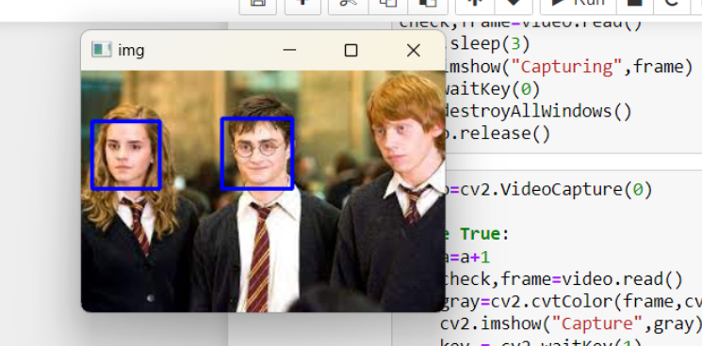
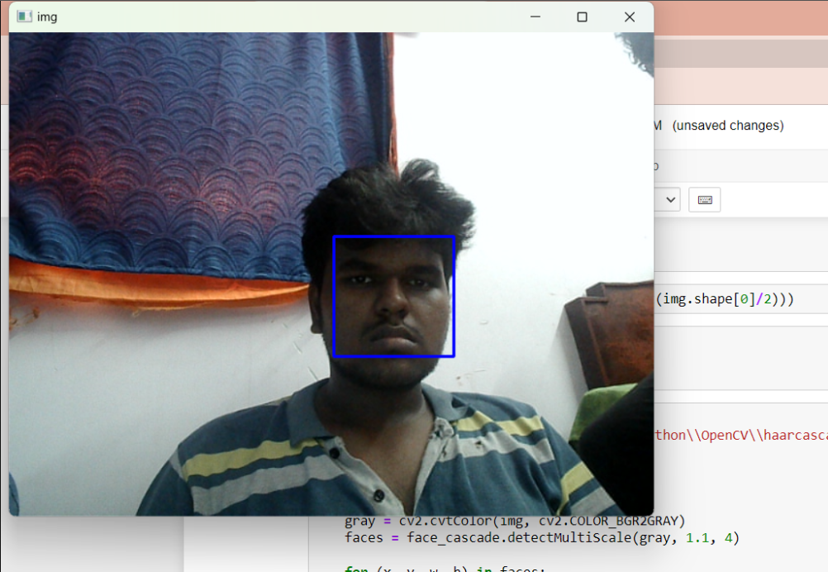
Work done(2/5)
Face Detecting in Video

Slide 9
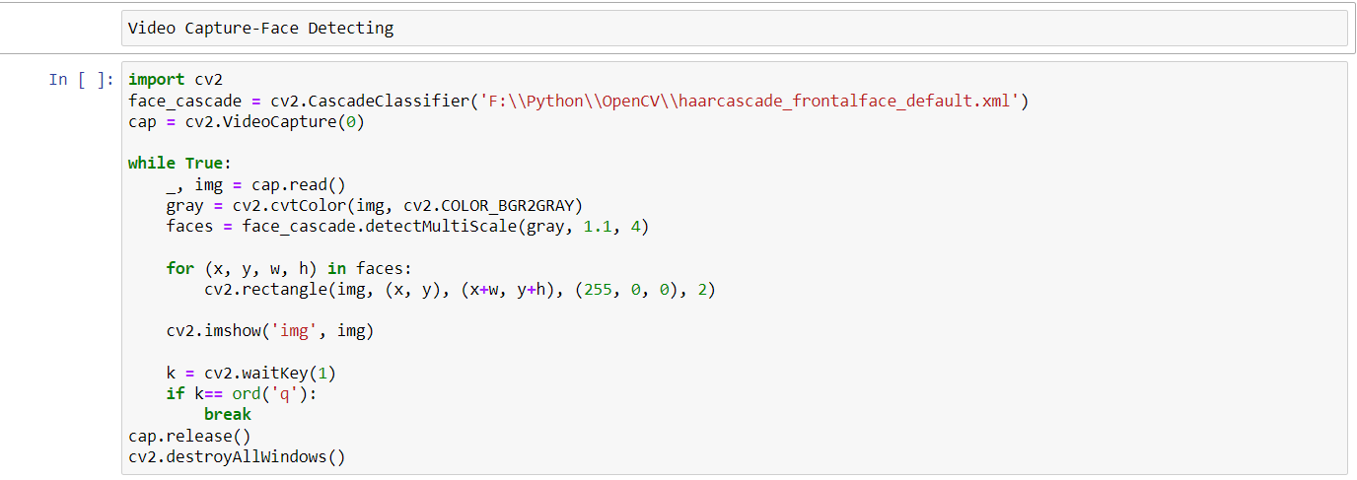
Work done(3/5)

Slide 10
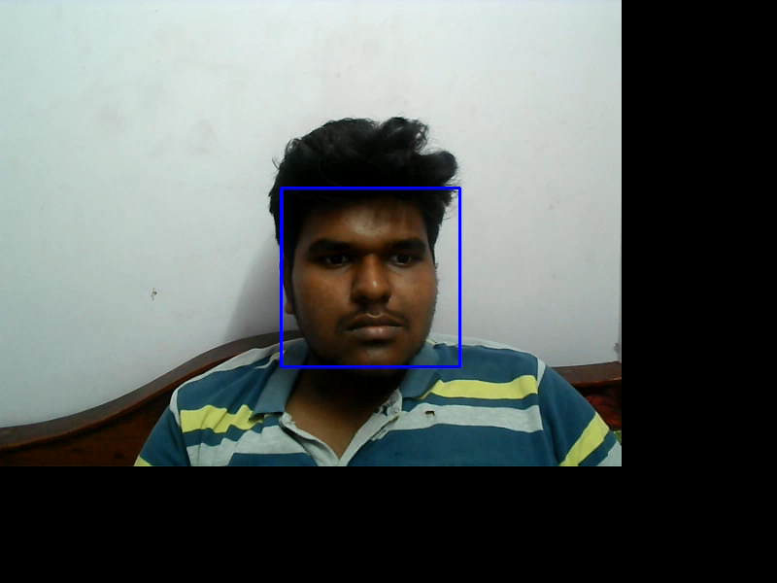
Work done(4/5)

Slide 11
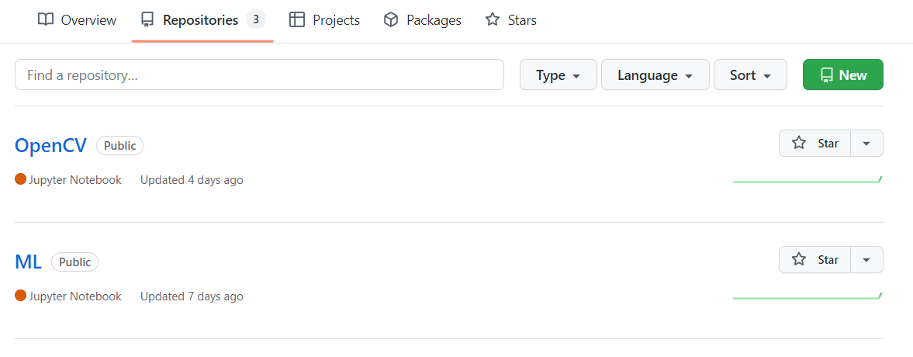
Work done(5/5)
Created Repositories in GitHub
Basic Machine Algorithms
OpenCV
GitHub Link:
https://github.com/Freakyavk

Slide 12
Timeline of the work
21-06-2022 | Created Repository on Machine Learning and uploaded basic machine learning algorithms(Linear Regression,Logistic Regression,KNN & SVM Algorithms)
22-06-2022 | Code on real-time face detection using webcams
23-06-2022 | Studied about Machine Learning and Deep Learning
24-06-2022 | Created a Repository on OpenCV and uploaded the programs for Basic OpenCV and Face Detection
25-06-2022 | Objective of the project , Yoga Poses for input , Literature Review
27-06-2022 | Problem Statement

Slide 13
Reference
Video Reference:
https://www.youtube.com/watch?v=UeXCqE7YNIY
https://www.youtube.com/watch?v=7IFhsbfby9s
https://www.youtube.com/watch?v=-ZrDjwXZGxI
https://www.youtube.com/watch?v=RGOj5yH7evk
Paper Reference:
https://nsarafianos.github.io/assets/3DHumanPose.pdf
https://scholarworks.sjsu.edu/cgi/viewcontent.cgi?article=1932&context=etd_projects
Website used for downloading packages:
https://pypi.org/project/opencv-python/

Slide 14
Thank you

